Slide 1
Digital Image Processing
Chapter 11:
Image Description and
Representation

Slide 2
Image Representation and Description?
Objective:
To represent and describe information embedded in
an image in other forms that are more suitable than the
image itself.
Benefits:
- Easier to understand
- Require fewer memory, faster to be processed
- More “ready to be used”
What kind of information we can use?
- Boundary, shape
- Region
- Texture
- Relation between regions

Slide 3
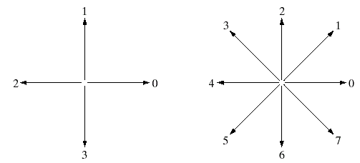
Shape Representation by Using Chain Codes
Why we focus on a boundary?
The boundary is a good representation of an object shape
and also requires a few memory.
Chain codes: represent an object boundary by a connected
sequence of straight line segments of specified length
and direction.
4-directional
chain code
8-directional
chain code
(Images from Rafael C.
Gonzalez and Richard E.
Wood, Digital Image
Processing, 2nd Edition.

Slide 4
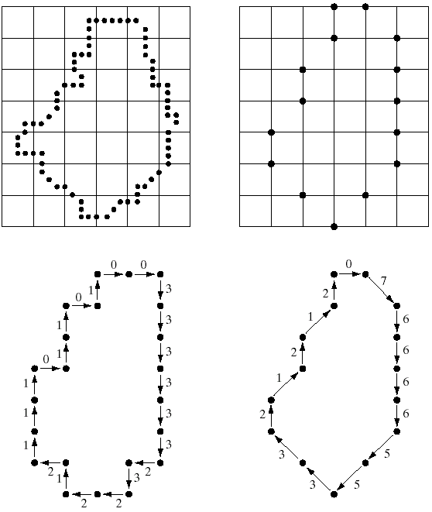
Examples of Chain Codes
Object
boundary
(resampling)
Boundary
vertices
4-directional
chain code
8-directional
chain code
(Images from Rafael C. Gonzalez and Richard E.
Wood, Digital Image Processing, 2nd Edition.

Slide 5
The First Difference of a Chain Codes
Problem of a chain code:
a chain code sequence depends on a starting point.
Solution: treat a chain code as a circular sequence and redefine the
starting point so that the resulting sequence of numbers forms an
integer of minimum magnitude.
The first difference of a chain code: counting the number of direction
change (in counterclockwise) between 2 adjacent elements of the code.
Example:
Chain code : The first
difference
0 → 1 1
0 → 2 2
0 → 3 3
2 → 3 1
2 → 0 2
2 → 1 3
Example:
- a chain code: 10103322
- The first difference = 3133030
- Treating a chain code as a
circular sequence, we get
the first difference = 33133030
1
2
0
3
The first difference is rotational
invariant.

Slide 6
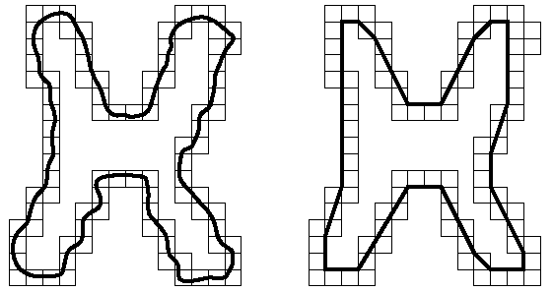
Polygon Approximation
Represent an object boundary by a polygon
Object boundary
Minimum perimeter
polygon
Minimum perimeter polygon consists of line segments that
minimize distances between boundary pixels.
(Images from Rafael C. Gonzalez and Richard E.
Wood, Digital Image Processing, 2nd Edition.

Slide 7
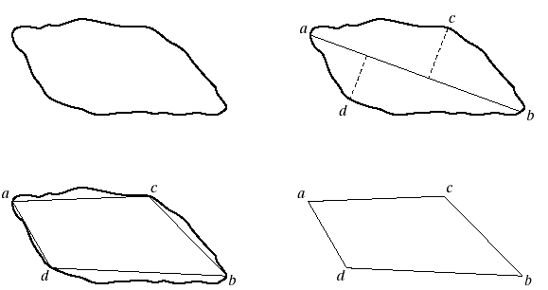
Polygon Approximation:Splitting Techniques
1. Find the line joining
two extreme points
0. Object boundary
2. Find the
farthest points
from the line
3. Draw a polygon
(Images from Rafael C. Gonzalez and Richard E.
Wood, Digital Image Processing, 2nd Edition.

Slide 8
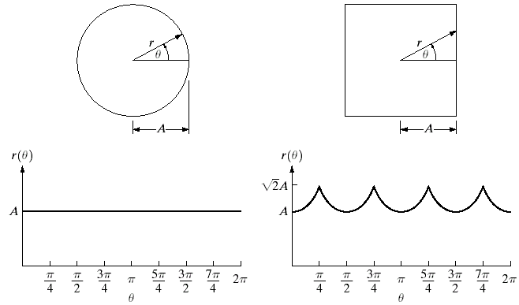
Distance-Versus-Angle Signatures
Represent an 2-D object boundary in term of a 1-D function
of radial distance with respect to θ.
(Images from Rafael C. Gonzalez and Richard E.
Wood, Digital Image Processing, 2nd Edition.

Slide 9
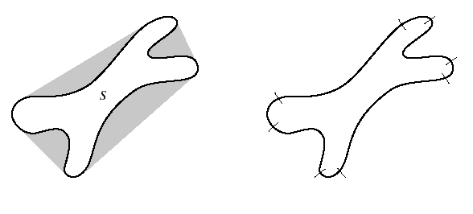
Boundary Segments
Concept: Partitioning an object boundary by using vertices
of a convex hull.
Partitioned boundary
Convex hull (gray color)
Object boundary
(Images from Rafael C. Gonzalez and Richard E.
Wood, Digital Image Processing, 2nd Edition.

Slide 10
Convex Hull Algorithm
Input : A set of points on a cornea boundary
Output: A set of points on a boundary of a convex hull of a cornea
1. Sort the points by x-coordinate to get a sequence p₁, p₂, … ,p_{n}
For the upper side of a convex hull
2. Put the points p₁ and p₂ in a list L_{upper} with p₁ as the first point
3. For i = 3 to n
4. Do append p_{i} to L_{upper}
5. While L_{upper} contains more than 2 points and the last 3
points in L_{upper} do not make a right turn
6. Do delete the middle point of the last 3 points from L_{upper}
Turn
Left
NOK!
Turn
Right
OK!
Turn
Right
OK!

Slide 11
Convex Hull Algorithm (cont.)
For the lower side of a convex hull
7. Put the points p_{n} and p_{n-1} in a list L_{lower} with p_{n} as the first point
8. For i = n-2 down to 1
9. Do append p_{i} to L_{lower}
While L_{lower} contains more than 2 points and the last 3 points
in L_{lower} do not make a right turn
Do delete the middle point of the last 3 points from L_{lower}
12. Remove the first and the last points from L_{lower}
13. Append L_{lower} to L_{upper} resulting in the list L
14. Return L
Turn
Right
OK!
Turn
Right
OK!
Turn
Left
NOK!

Slide 12
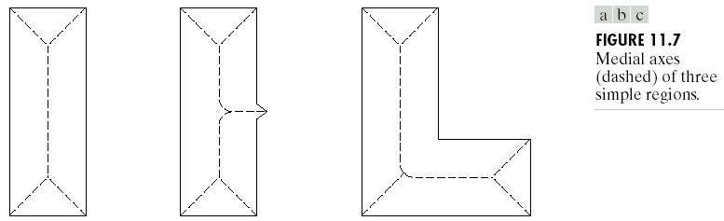
Skeletons
Obtained from thinning or skeletonizing processes
Medial axes (dash lines)
(Images from Rafael C. Gonzalez and Richard E.
Wood, Digital Image Processing, 2nd Edition.

Slide 13
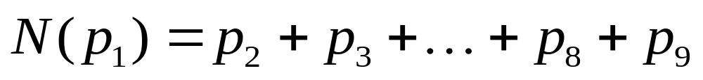
Thinning Algorithm
Concept: 1. Do not remove end points
2. Do not break connectivity
3. Do not cause excessive erosion
Apply only to contour pixels: pixels “1” having at least one of its 8
neighbor pixels valued “0”
Notation:
p₉
p₂
p₃
Neighborhood
arrangement
for the thinning
algorithm
Let
p₈
p₁
p₄
=
p₇
p₆
p₅
Example
Let
0
0
1
T(p₁) = the number of transition 0-1 in
the ordered sequence p₂, p₃, …
, p₈, p₉, p₂.
1
p₁
0
1
0
1
N(p₁) = 4
T(p₁) = 3

Slide 14





Thinning Algorithm (cont.)
Step 1. Mark pixels for deletion if the following conditions are true.
a)
b) T(p₁) =1
c)
d)
(Apply to all border pixels)
p₉
p₂
p₃
p₈
p₁
p₄
p₇
p₆
p₅
Step 2. Delete marked pixels and go to Step 3.
Step 3. Mark pixels for deletion if the following conditions are true.
a)
b) T(p₁) =1
c)
d)
(Apply to all border pixels)
Step 4. Delete marked pixels and repeat Step 1 until no change
occurs.

Slide 15
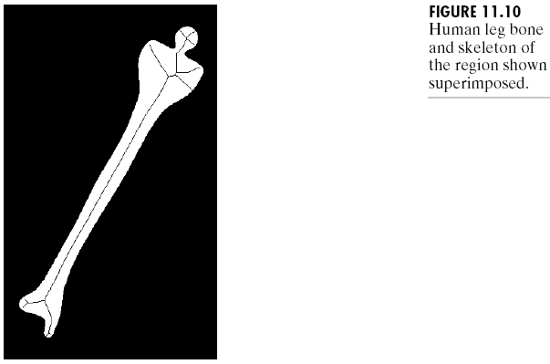
Example: Skeletons Obtained from the Thinning Alg.
Skeleton
(Images from Rafael C. Gonzalez and Richard E.
Wood, Digital Image Processing, 2nd Edition.

Slide 16
Boundary Descriptors
1. Simple boundary descriptors:
we can use
- Length of the boundary
- The size of smallest circle or box that can totally
enclosing the object
2. Shape number
3. Fourier descriptor
4. Statistical moments

Slide 17
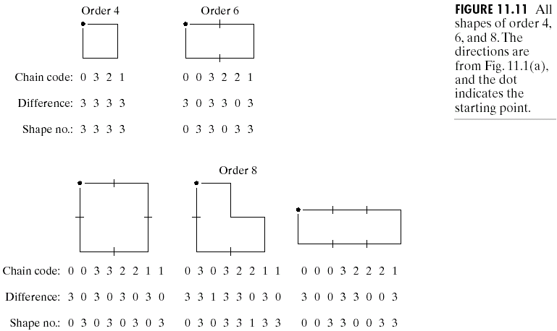
Shape Number
Shape number of the boundary definition:
the first difference of smallest magnitude
The order n of the shape number:
the number of digits in the sequence
1
2
0
3
(Images from Rafael C. Gonzalez and Richard E.
Wood, Digital Image Processing, 2nd Edition.

Slide 18
Shape Number (cont.)
Shape numbers of order
4, 6 and 8
(Images from Rafael C. Gonzalez and Richard E.
Wood, Digital Image Processing, 2nd Edition.

Slide 19
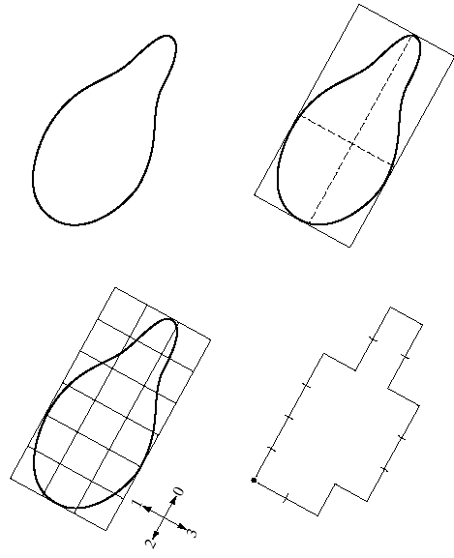
Example: Shape Number
2. Find the smallest rectangle
that fits the shape
1. Original boundary
Chain code:
0 0 0 0 3 0 0 3 2 2 3 2 2 2 1 2 1 1
First difference:
3 0 0 0 3 1 0 3 3 0 1 3 0 0 3 1 3 0
Shape No.
0 0 0 3 1 0 3 3 0 1 3 0 0 3 1 3 0 3
4. Find the nearest
Grid.
3. Create grid
(Images from Rafael C. Gonzalez and Richard E.
Wood, Digital Image Processing, 2nd Edition.

Slide 20

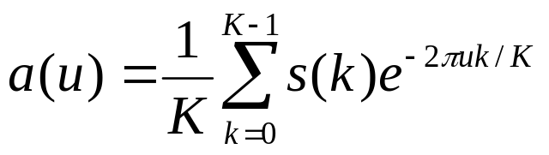
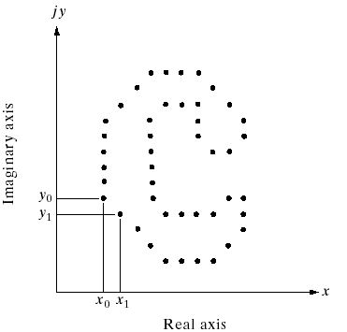
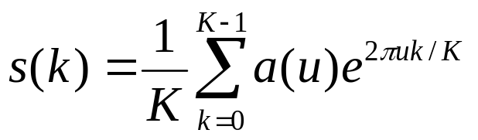
Fourier Descriptor
Fourier descriptor: view a coordinate (x,y) as a complex number
(x = real part and y = imaginary part) then apply the Fourier
transform to a sequence of boundary points.
Let s(k) be a coordinate
of a boundary point k :
Fourier descriptor :
Reconstruction formula
Boundary
points
(Images from Rafael C. Gonzalez and Richard E.
Wood, Digital Image Processing, 2nd Edition.

Slide 21
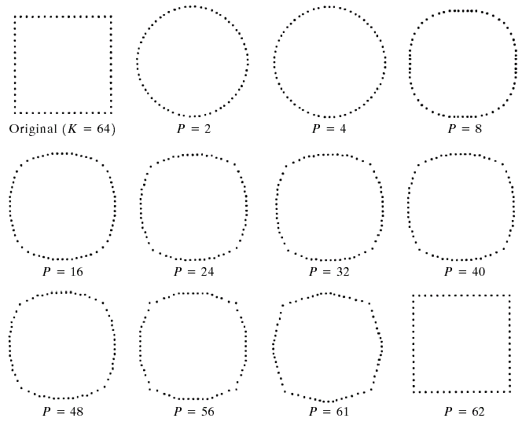
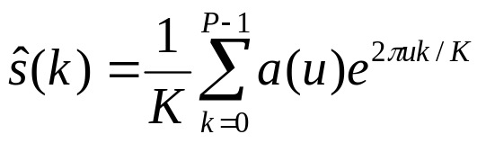
Example: Fourier Descriptor
Examples of reconstruction from Fourier descriptors
P is the number of
Fourier coefficients
used to reconstruct
the boundary
(Images from Rafael C. Gonzalez and Richard E.
Wood, Digital Image Processing, 2nd Edition.

Slide 22
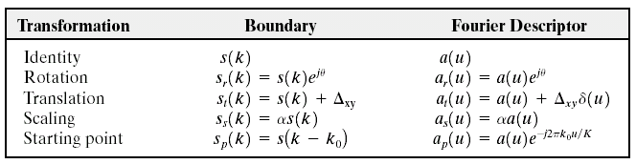
Fourier Descriptor Properties
Some properties of Fourier descriptors
(Images from Rafael C. Gonzalez and Richard E.
Wood, Digital Image Processing, 2nd Edition.

Slide 23
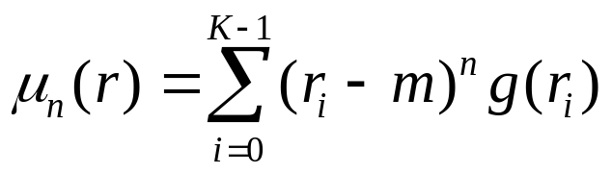
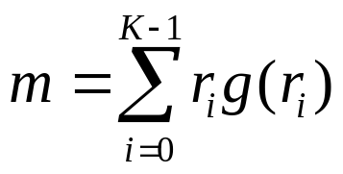
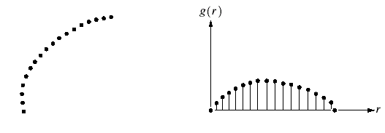
Statistical Moments
Definition: the n^{th} moment
Example of moment:
The first moment = mean
The second moment = variance
where
Boundary
segment
1D graph
Convert a boundary segment into 1D graph
View a 1D graph as a PDF function
Compute the n^{th} order moment of the graph
(Images from Rafael C.
Gonzalez and Richard E.
Wood, Digital Image
Processing, 2nd Edition.

Slide 24
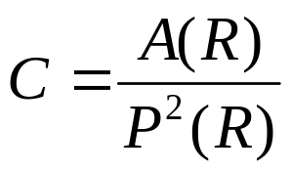
Regional Descriptors
Purpose: to describe regions or “areas”
1. Some simple regional descriptors
- area of the region
- length of the boundary (perimeter) of the region
- Compactness
where A(R) and P(R) = area and perimeter of region R
Example: a circle is the most compact shape with C = 1/4π
2. Topological Descriptors
3. Texture
4. Moments of 2D Functions

Slide 25
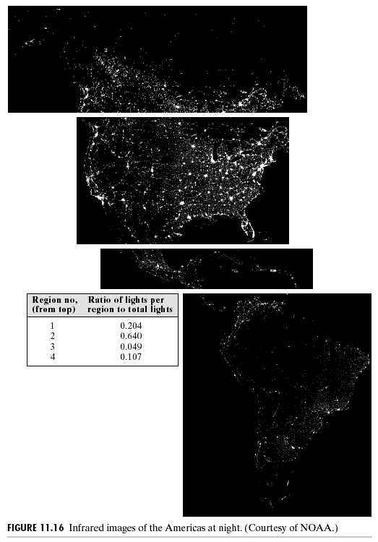
Example: Regional Descriptors
White pixels represent
“light of the cities”
% of white pixels
Region no. compared to the
total white pixels
20.4%
64.0%
4.9%
10.7%
Infrared image of America at night
(Images from Rafael C. Gonzalez and Richard E.
Wood, Digital Image Processing, 2nd Edition.

Slide 26
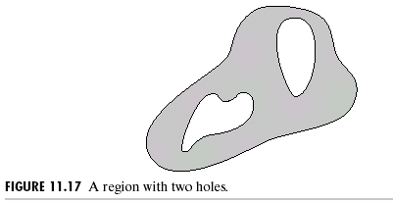

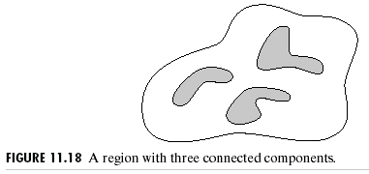
Topological Descriptors
Use to describe holes and connected components of the region
Euler number (E):
C = the number of connected
components
H = the number of holes
(Images from Rafael C. Gonzalez and Richard E.
Wood, Digital Image Processing, 2nd Edition.

Slide 27
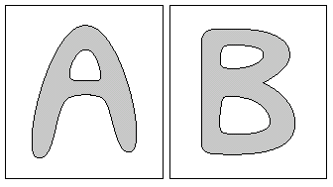
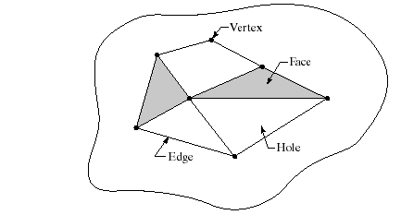

Topological Descriptors (cont.)
E = -1
E = 0
Euler Formula
V = the number of vertices
Q = the number of edges
F = the number of faces
E = -2
(Images from Rafael C. Gonzalez and Richard E.
Wood, Digital Image Processing, 2nd Edition.

Slide 28
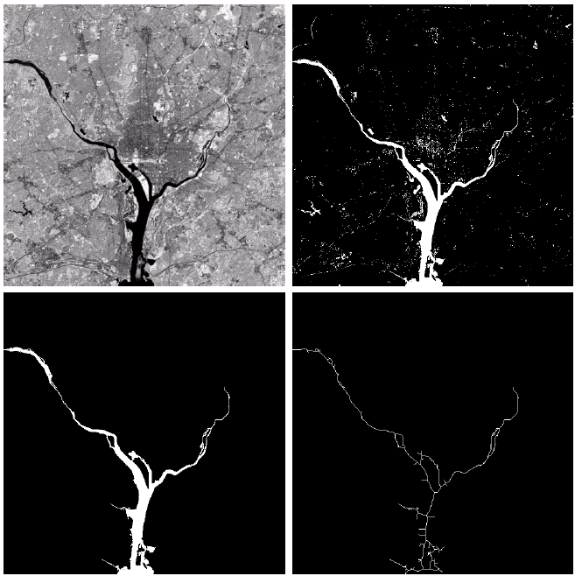
Example: Topological Descriptors
Original image:
Infrared image
Of Washington
D.C. area
After intensity
Thresholding
(1591 connected
components
with 39 holes)
Euler no. = 1552
The largest
connected
area
(8479 Pixels)
(Hudson river)
After thinning
(Images from Rafael C. Gonzalez and Richard E.
Wood, Digital Image Processing, 2nd Edition.

Slide 29
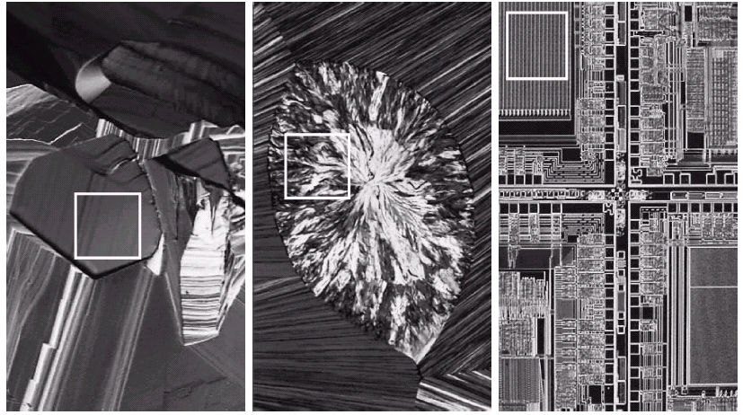
Texture Descriptors
Purpose: to describe “texture” of the region.
Examples: optical microscope images:
B
C
A
Superconductor
(smooth texture)
Cholesterol
(coarse texture)
Microprocessor
(regular texture)
(Images from Rafael C. Gonzalez and Richard E.
Wood, Digital Image Processing, 2nd Edition.

Slide 30
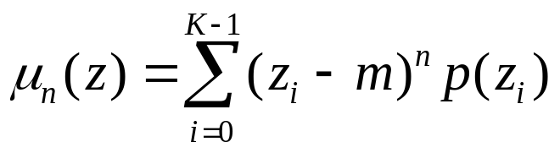
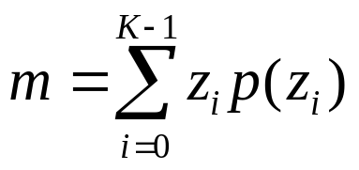
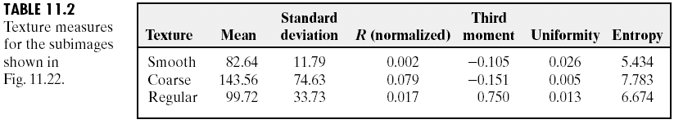
Statistical Approaches for Texture Descriptors
We can use statistical moments computed from an image histogram:
z = intensity
p(z) = PDF or histogram of z
where
Example: The 2nd moment = variance → measure “smoothness”
The 3rd moment → measure “skewness”
The 4th moment → measure “uniformity” (flatness)
A
B
C
(Images from Rafael C. Gonzalez and Richard E.
Wood, Digital Image Processing, 2nd Edition.

Slide 31
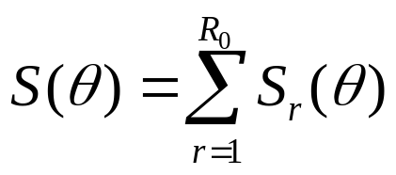
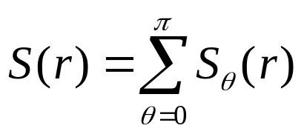
Fourier Approach for Texture Descriptor
Concept: convert 2D spectrum into 1D graphs
Original
image
Fourier
coefficient
image
FFT2D
+FFTSHIFT
Divide into areas
by angles
Divide into areas
by radius
Sum all pixels
in each area
Sum all pixels
in each area

Slide 32
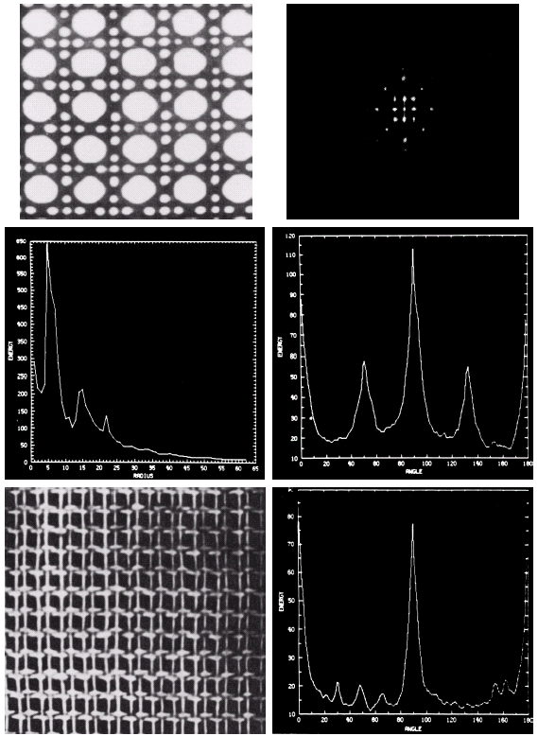
Fourier Approach for Texture Descriptor
Original
image
2D Spectrum
(Fourier Tr.)
S(r)
S(θ)
Another
image
Another S(θ)
(Images from Rafael C.
Gonzalez and Richard E.
Wood, Digital Image
Processing, 2nd Edition.

Slide 33
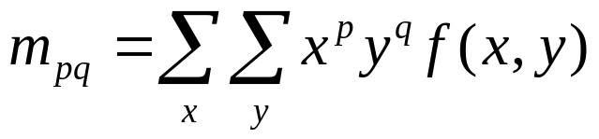
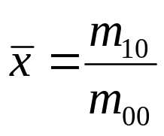
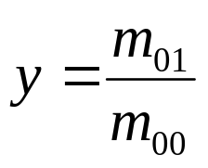
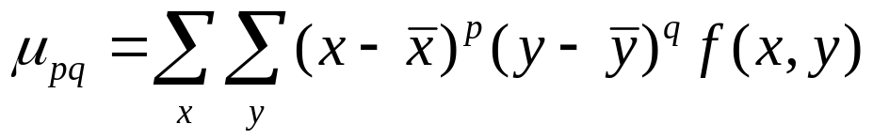





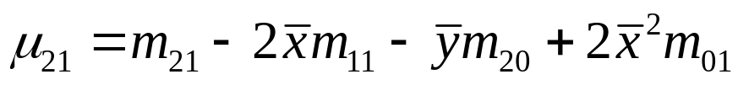
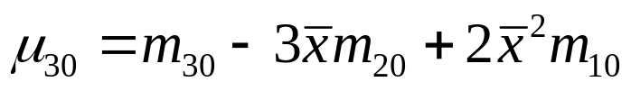
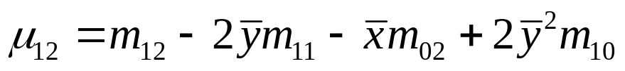
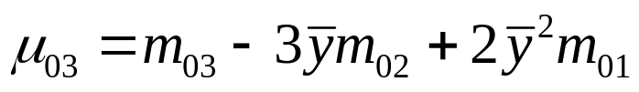
Moments of Two-D Functions
The moment of order p + q
The central moments of order p + q

Slide 34
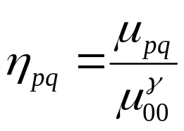
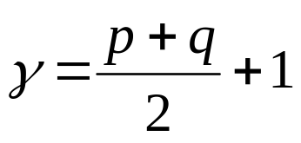

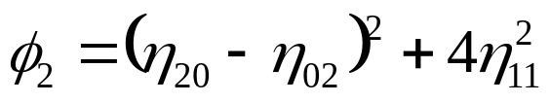
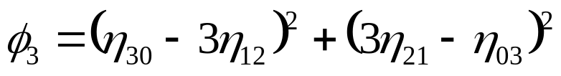
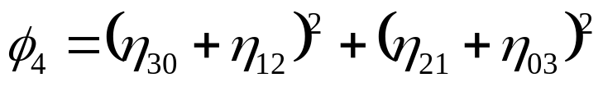
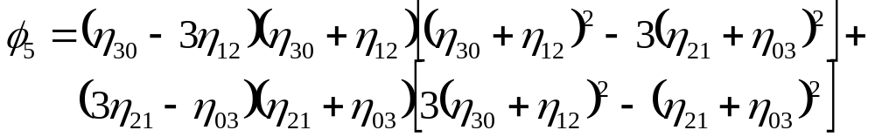
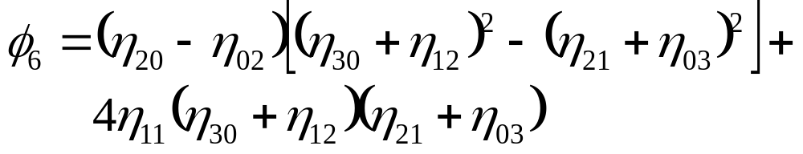
Invariant Moments of Two-D Functions
The normalized central moments of order p + q
where
Invariant moments: independent of rotation, translation, scaling,
and reflection

Slide 35
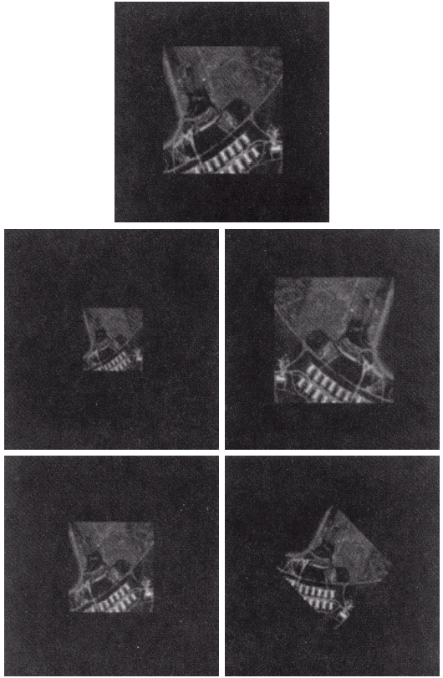
Example: Invariant Moments of Two-D Functions
1. Original image
2. Half size
3. Mirrored
4. Rotated 2 degree
5. Rotated 45 degree
(Images from Rafael C. Gonzalez and Richard E.
Wood, Digital Image Processing, 2nd Edition.

Slide 36

Example: Invariant Moments of Two-D Functions
Invariant moments of images in the previous slide
Invariant moments are independent of rotation, translation,
scaling, and reflection
(Images from Rafael C. Gonzalez and Richard E.
Wood, Digital Image Processing, 2nd Edition.

Slide 37




Principal Components for Description
Purpose: to reduce dimensionality of a vector image while maintaining
information as much as possible.
Let
Mean:
Covariance matrix

Slide 38




Hotelling transformation
Let
Where A is created from eigenvectors of C_{x} as follows
Row 1 contain the 1st eigenvector with the largest eigenvalue.
Row 2 contain the 2nd eigenvector with the 2nd largest eigenvalue.
….
Then we get
and
Then elements of are uncorrelated. The
component of y with the largest λ is called the principal
component.

Slide 39

Eigenvector and Eigenvalue
Eigenvector and eigenvalue of Matrix C are defined as
Let C be a matrix of size NxN and e be a vector of size Nx1.
If
Where λ is a constant
We call e as an eigenvector and λ as eigenvalue of C

Slide 40


Example: Principal Components
6 spectral images
from an airborne
Scanner.
(Images from Rafael C. Gonzalez and Richard E.
Wood, Digital Image Processing, 2nd Edition.

Slide 41

Example: Principal Components (cont.)
Component λ
3210
931.4
118.5
83.88
64.00
13.40
(Images from Rafael C. Gonzalez and Richard E.
Wood, Digital Image Processing, 2nd Edition.

Slide 42
Example: Principal Components (cont.)
Original image
After Hotelling transform

Slide 43

Principal Components for Description
(Images from Rafael C. Gonzalez and Richard E.
Wood, Digital Image Processing, 2nd Edition.

Slide 44

Relational Descriptors
(Images from Rafael C. Gonzalez and Richard E.
Wood, Digital Image Processing, 2nd Edition.

Slide 45

Relational Descriptors
(Images from Rafael C. Gonzalez and Richard E.
Wood, Digital Image Processing, 2nd Edition.

Slide 46

Relational Descriptors
(Images from Rafael C. Gonzalez and Richard E.
Wood, Digital Image Processing, 2nd Edition.

Slide 47


Relational Descriptors
(Images from Rafael C. Gonzalez and Richard E.
Wood, Digital Image Processing, 2nd Edition.

Slide 48


Relational Descriptors
(Images from Rafael C. Gonzalez and Richard E.
Wood, Digital Image Processing, 2nd Edition.

Slide 49

Structural Approach for Texture Descriptor
(Images from Rafael C. Gonzalez and Richard E.
Wood, Digital Image Processing, 2nd Edition.

